Slide 1
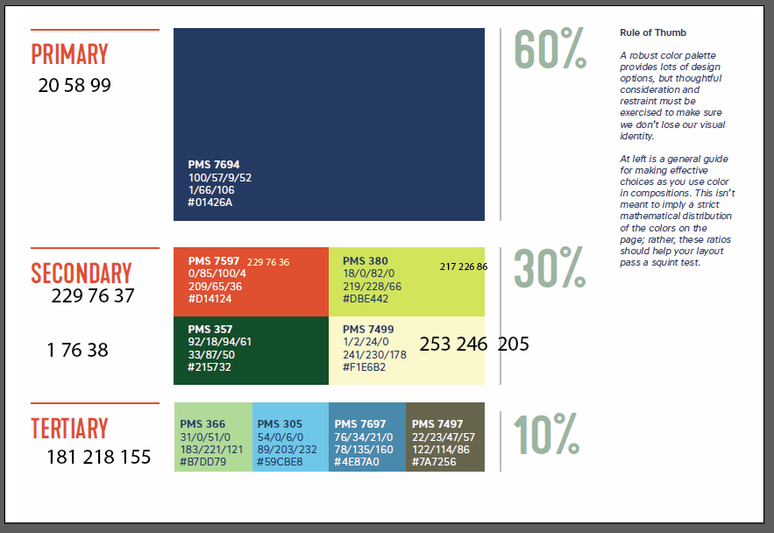
Titles should be at least 72 points (one inch)
Author
Affiliation
Date
The abstract or thesis statement should be prominent.
Text should be no less than 36 point (0.5 inch).
Use two or three columns.
Be sure to include references and acknowledgements.
Research Motivation
or Project Goals
This page is setup to be 44” wide by 36”tall.
The plotter paper is 44” wide,
so one dimension must be not larger than 44”.

